Slide 1
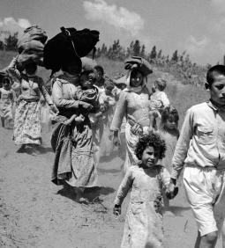
What were the consequences of the Nakba for the Palestinians?
Lesson 7

Slide 2
Learning objectives
By the end of this lesson, you should be able to:
Describe the key events of 1947 and 1948 in Mandate Palestine
Explain what the Nakba was
Examine the consequences of 1947 and 1948, including the Nakba, for Palestinians and Jews

Slide 3
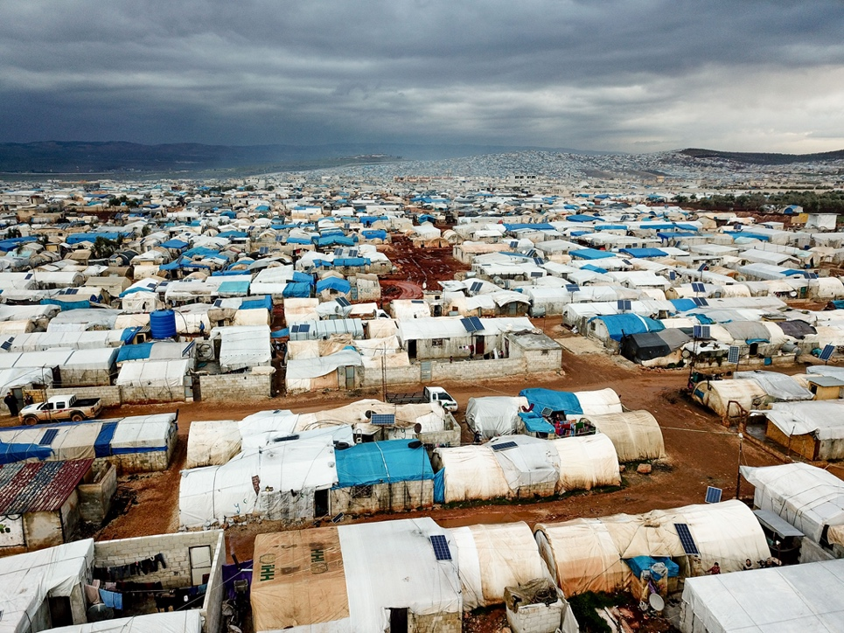
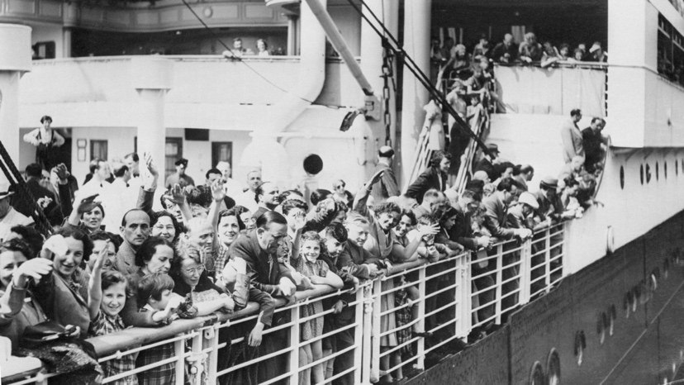
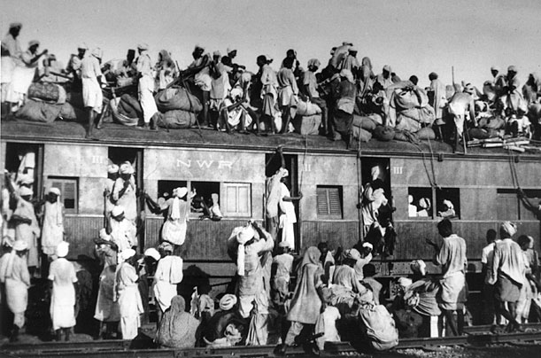
Starter activity
A Syrian refugee camp. Since the start of the Syrian civil war in 2011, over 13 million Syrians have been displaced
Jewish refugees fleeing Nazi Germany in WWII
What does it mean to be a refugee?
Why do people become refugees?
Can you think of any examples?
When India was partitioned in 1947, over 10 million people became refugees

Slide 4
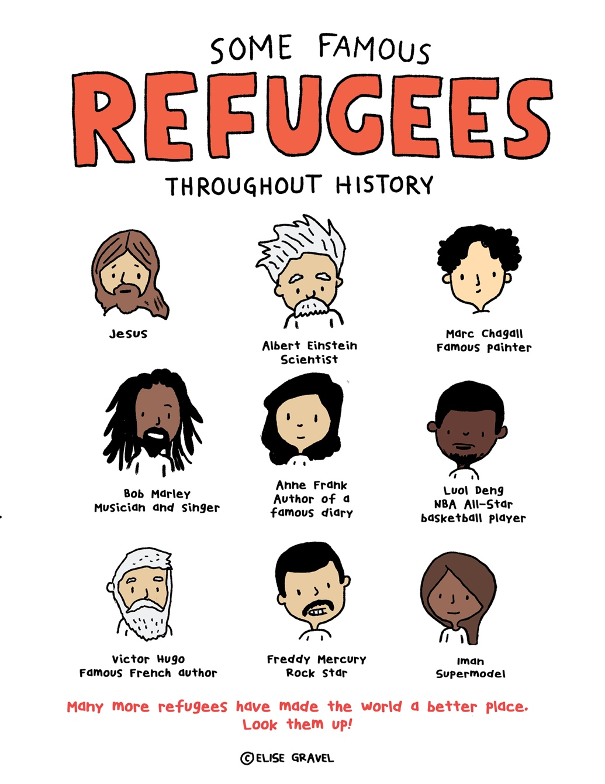
7a. Stick this into your book

Slide 5
Can you define any of these terms?
Refugee
Right of Return
Nakba
UN Resolution 194
Ethnic cleansing

Slide 6
Today’s keywords – add these to your glossary:
Refugee: someone who cannot or will not return home due to well-founded fear of persecution
Right of Return: a principle in international law which guarantees everyone’s right to return to their country
Nakba: Arabic for “catastrophe”, when 750,000 Palestinians (half of the Palestinian population) were forced to leave their homes and became refugees in 1948 – this is an example of ethnic cleansing
UN Resolution 194: a resolution adopted by the United Nations in 1948 which stated that Palestinian refugees should be able to return to their homes or be financially compensated
Ethnic cleansing: the systematic forced removal of an ethnic, racial or religious group from a particular area

Slide 7
Recap
World War Two
The Holocaust
Ernest Bevin, British Foreign Secretary, limiting Jewish arrivals to Mandate Palestine at 18,000 a year in 1945
Jewish opposition to Britain’s limits to Jewish arrivals in Mandate Palestine and the brutal attacks by the Irgun and the Lehi in response to this
Increased international calls for an independent Jewish state as the full horrors of the Holocaust came to light
British concerns about a repeat of the 1936-1939 Arab Revolt
You are now going to be put into small groups
Your group will be assigned a colour: green, yellow or blue
How did your assigned factors opposite contribute to Britain’s decision to ask the UN for help with Mandate Palestine in February 1947?
Extension question: can you see any links between your group’s factors?

Slide 8
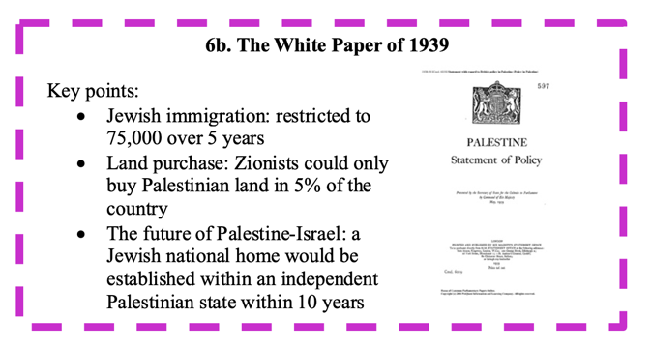
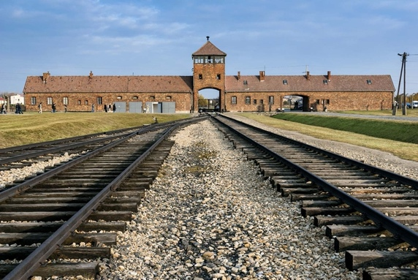
Britain approaches the UN
As we have seen, there was increasing tension between Palestinians and Jews in Mandate Palestine in the 1920s and 1930s, which often turned into violence. This came to a head with the 1936-1939 Arab Revolt
The White Paper of 1939 had restricted Jewish arrivals to 75,000 over 5 years
As the full horrors of the Holocaust started to come to light, in 1945 Ernest Bevin (British Foreign Secretary) increased the limit for Jewish arrivals to 18,000 a year

Slide 9
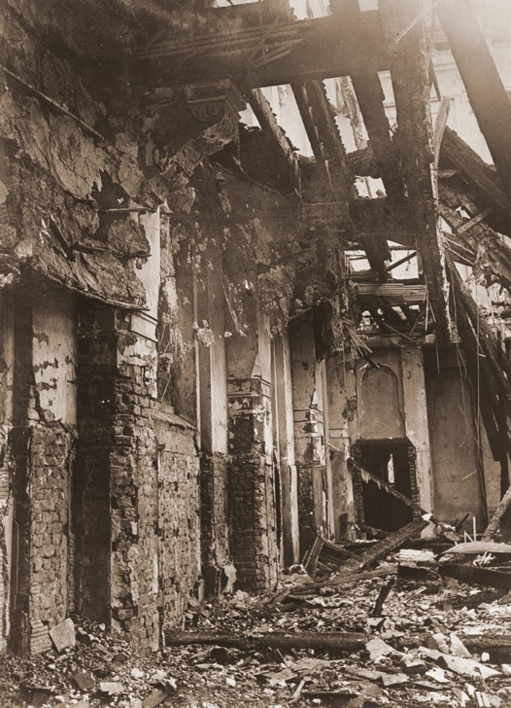
Britain approaches the UN
Many Jews within Mandate Palestine and beyond still thought this was unjust
Two extremist opposition groups - the Irgun and the Lehi - commenced a series of brutal attacks in Mandate Palestine
There were also increasing calls at this time for an independent Jewish state
The British were worried about the Palestinians: the Palestinians had lived on this land for centuries and they had never received their promised independent state
In February 1947, Britain asked the UN for help

Slide 10
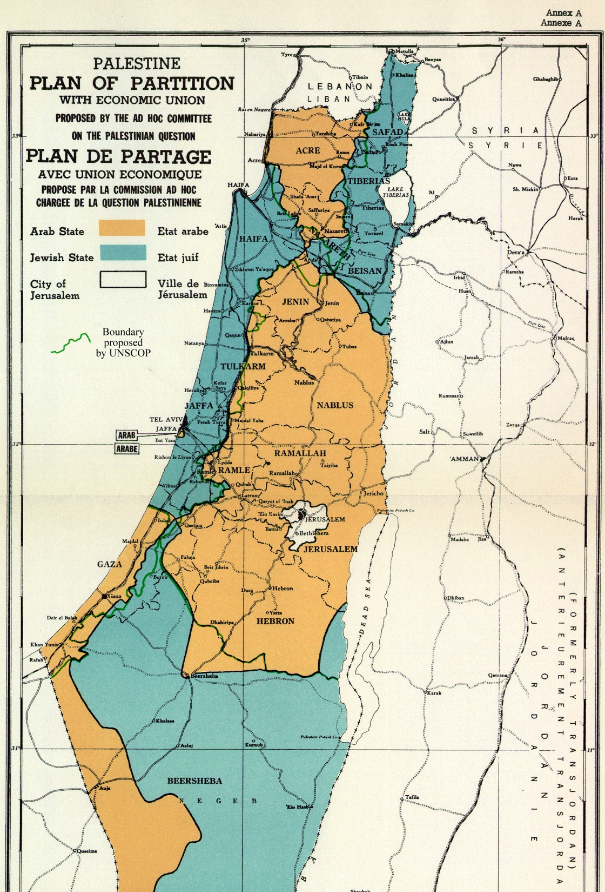
What did the UN say?
Where have we seen the idea of partitioning Mandate Palestine before?
At the start of the Arab Revolt of 1936-1939
May 1947: the UN established a Special Committee on Palestine (UNSCOP)
Summer 1947: UNSCOP travelled to Mandate Palestine to investigate
September 1947: UNSCOP declared that Mandate Palestine should be partitioned into separate Palestinian and Jewish states (but Jerusalem and Bethlehem should be under international control and accessible to both Palestinians and Jews)
This was UN Resolution 181
Use this information to complete Worksheet 7b

Slide 11
7b. What did the UN say? Match up the dates with the decisions and answer the questions
What was UNSCOP?
United Nations Special Committee on Palestine
UNSCOP said that Mandate Palestine should be partitioned into separate Palestinian and Jewish states
May 1947
Summer 1947
UNSCOP was established
September 1947
UNSCOP travelled to Mandate Palestine
What is this decision known as?
UN Resolution 181

Slide 12
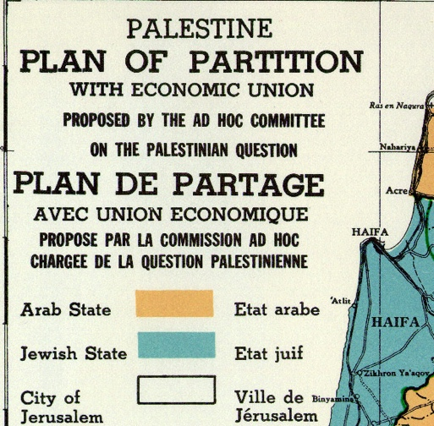
55% of Mandate Palestine was to be a Jewish state
7c. Debate
Stick this sheet into your book.
With a partner, take it in turns to think about this decision from a Palestinian and a Jewish perspective.
After a few minutes, switch and think about this from the other perspective.
If your partner makes any points that you hadn’t thought of, write these down.
But only 33% of the population of Mandate Palestine was Jewish at this time
And Jews owned less than 10% of the land of Mandate Palestine

Slide 13
Reactions to the UN Partition Plan:
The Palestinians were not happy. They would only have 45% of their country left. Couldn’t European countries take in more Jewish refugees from the Holocaust?
On the other hand, most Jews were happy with the UN Partition Plan
How do these reactions compare to what you expected?

Slide 14
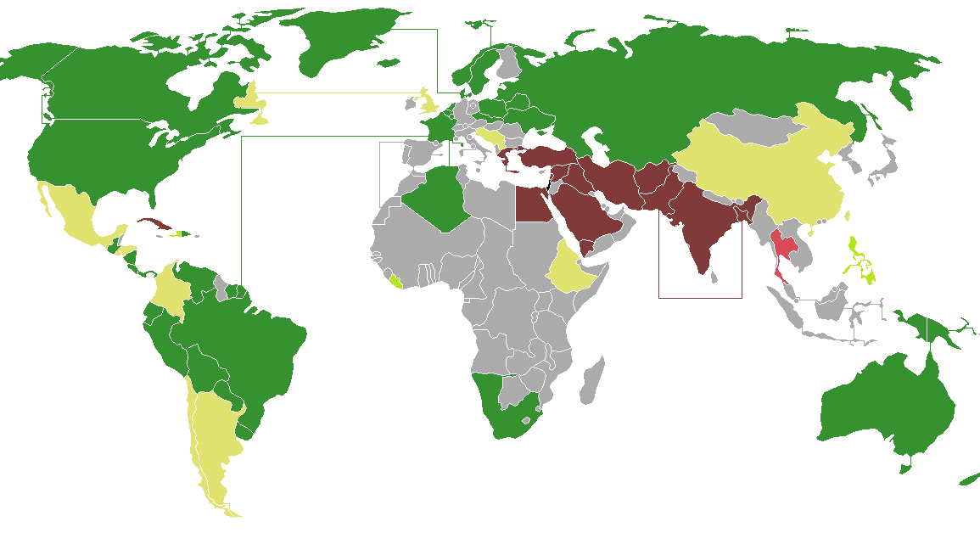
The vote
The UN Partition Plan was taken to a vote between nations
On 29th November 1947, the UN Partition Plan (Resolution 181) was passed
As we saw last lesson, there was much support for an independent Jewish state at this time
The USA was in favour of the Partition Plan, and many European countries wanted to stay as allies with the USA after WW2
The USSR (Russia) voted for partition as it was keen to have the new Jewish state as an ally in the Middle East
Britain would now withdraw from Palestine and by August 1948 the country would be partitioned
Working with the person next to you, write a list of 5 countries that voted in favour of partition and 3 countries that voted against it

Slide 15
The vote
In favour of partition:
USA
USSR (Russia)
France
Canada
Australia
Brazil
South Africa
Against partition:
Syria
Lebanon
Iraq
Iran
Egypt
India
Turkey
Working with the person next to you, write a list of 5 countries that voted in favour of partition and 3 countries that voted against it

Slide 16
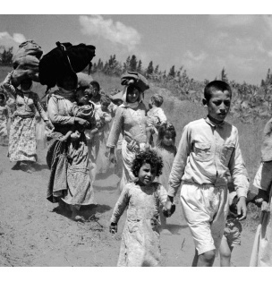
The Nakba
This is an important Arabic word. Try and copy it into your book
النكبة‎
Nakba
Not long after this decision, fighting broke out between Jews and Palestinians
What happened next is called the Nakba
Arabic for “catastrophe”
This is an example of ethnic cleansing: the systematic forced removal of an ethnic, racial or religious group (the Palestinians) from a particular area (Palestine)
This involved large-scale attacks aimed at expelling Palestinians from their towns and villages to build a future Jewish state
Palestinians fleeing their homes in 1948

Slide 17
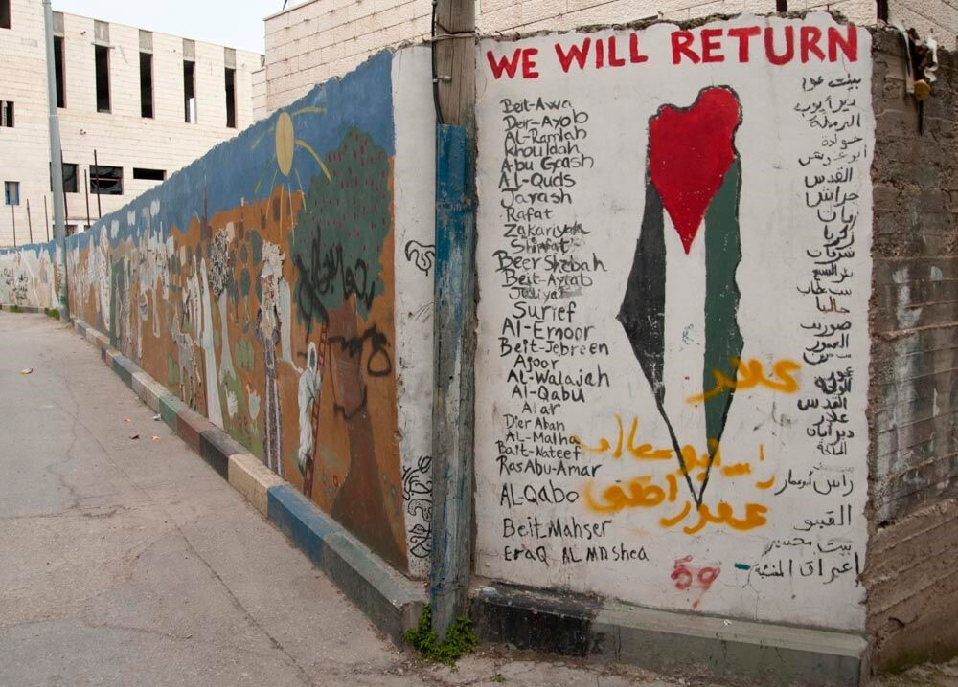
The Nakba: what happened?
النكبة‎
Shortly after the UN decision to partition Palestine in 1947, Zionist armed groups began attacking Palestinian people, towns and villages, aiming to expel them from Palestine
530 villages and cities were destroyed
15,000 Palestinians were killed in a series of mass atrocities, including more than 70 massacres
750,000 Palestinians (half of the Palestinian population) were forced to leave their homes and became refugees
Some of these actions were part of “Plan D” or “Plan Dalet”, a Zionist plan to expel the Palestinians from Palestine
Palestinians attacked Jewish individuals and communities during this period too
Is the Nakba ongoing in Israel’s treatment of the Palestinians today? We will return to this in a future lesson

Slide 18
7d. Massacres of the Nakba
Use the information on handout 7d to complete this table in your book
Town or village where massacre took place | Where was this town or village located? | What was life like here before 1948? | When did the massacre take place? | What happened?
Deir Yassin | On the outskirts of Jerusalem
Tantura |  |  | 22nd May 1948
Dawaymeh
Extension question: What is a refugee? Do the Palestinians fleeing their homes in 1948 fit this definition?

Slide 19
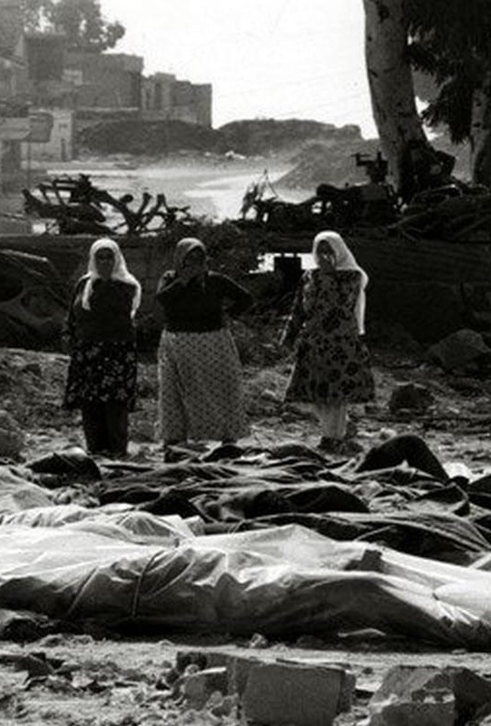
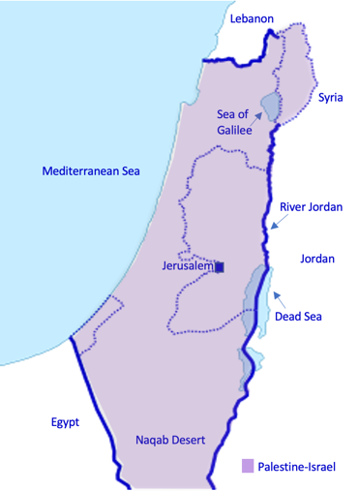
Deir Yassin
Deir Yassin was a village on the outskirts of Jerusalem, surrounded by olive, almond and fig trees
It was called Deir Yassin because there were the ruins of a monastery (‘Deir’ in Arabic) and a mosque named after Sheikh Yasin
Before the 1920s Deir Yassin was mostly dependent on agriculture, but after the 1920s it came to depend on its limestone too
In 1943 and 1946, primary schools were established for boys and girls in the village
In 1948, the population of Deir Yassin was 750
The village had signed a “non-aggression” pact that it would not get involved with the fighting. However, on 9th April 1948, members of the Irgun and Lehi attacked the village. They massacred between 100 and 250 people, including many women and children and there were reports of mutilations, rape and survivors being paraded through Jewish neighbourhoods before being executed

Slide 20
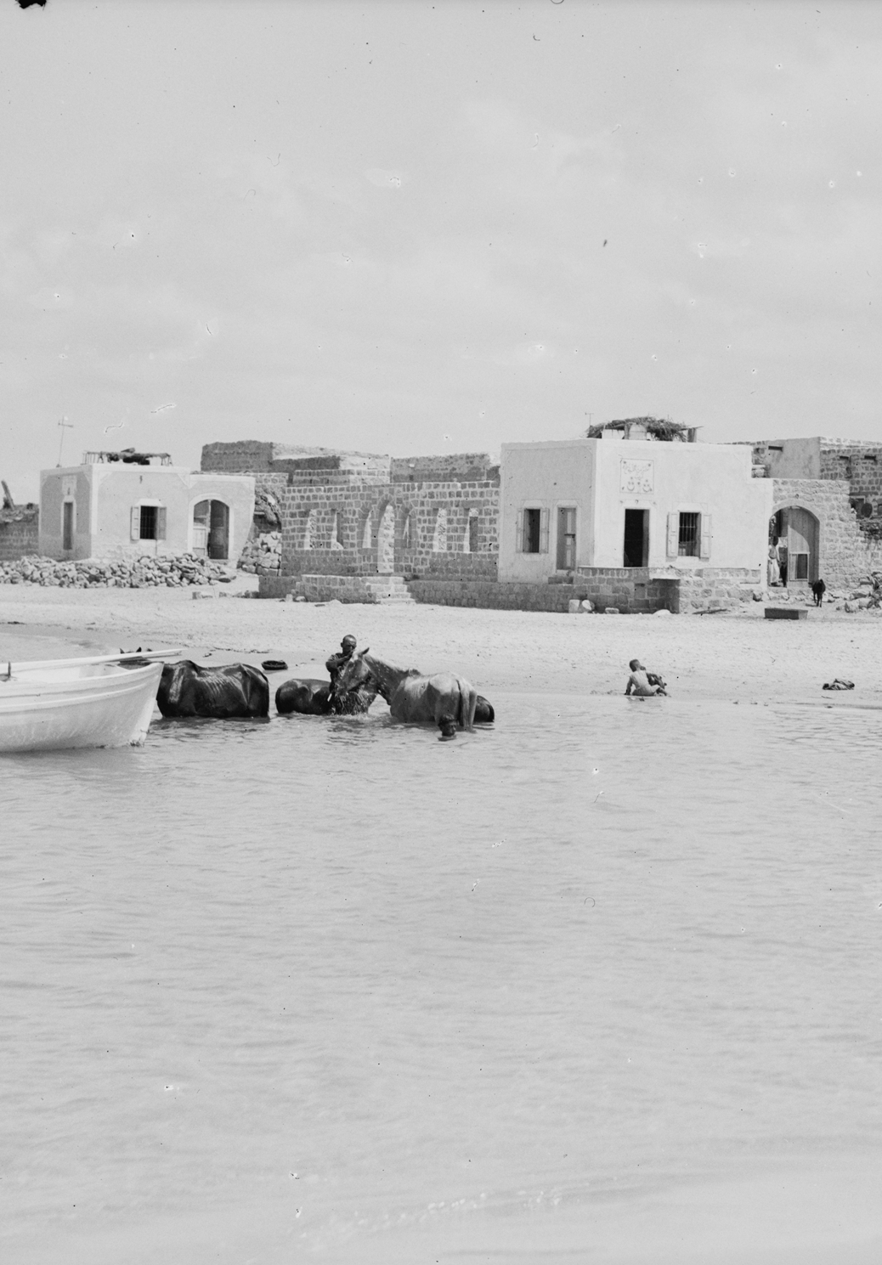
Tantura
Tantura was a coastal village, not far from the city of Haifa
Most people in the village made their living from fishing and agriculture, including citrus, bananas, grain and olives
A boy’s primary school was established in 1889, and a girl’s primary school in the 1930s
In 1945, the population of Tantura was 1500
On the evening of 22nd May 1948, Zionist forces attacked the village
The villagers surrendered but 200 Palestinian men were still shot dead on the beach
The other inhabitants of the village were expelled
At first they slept on the streets of a nearby village, but soon they were expelled from there too
Many of these Palestinian refugees and their children still live in refugee camps in Syria

Slide 21
Dawaymeh
The village of Dawaymeh was in the Hebron Mountains
Agriculture was the main source of income
In 1937, a primary school opened
In the 1940s, the village had 10 butchers and 30-50 small shops
On 29th October 1948, Zionists entered the village in twenty armored cars
They opened fire on the villagers, killing between 80 and 100 people, including women and children
Eyewitness accounts report babies whose skulls were cracked open, women raped or burnt alive in houses, and men stabbed to death

Slide 22
7d. Massacres of the Nakba
Use the information on handout 7d to complete this table in your book
Town or village where massacre took place | Where was this town or village located? | What was life like here before 1948? | When did the massacre take place? | What happened?
Deir Yassin | On the outskirts of Jerusalem
Tantura |  |  | 22nd May 1948
Dawaymeh
Schools had just opened for boys and girls
9th April 1948
Members of the Irgun and the Lehi attacked the village. They massacred between 100 and 250 people, including many women and children
On the coast, not far from Haifa
Most people made their living from fishing or agriculture
Zionist forces attacked the village and shot and killed 200 Palestinian men on the beach. The rest of the villagers were expelled
In the Hebron Mountains
The village had 10 butchers and 30-50 small shops
29th October 1948
Zionists entered the village in 20 armoured cars and killed between 80 and 100 people
Extension question: What is a refugee? Do the Palestinians fleeing their homes in 1948 fit this definition?

Slide 23
On the Nakba and ethnic cleansing:
Watch the first 3 minutes of this video
al-Majdal = a Palestinian port city that became the Israeli city of Ashkelon

Slide 24
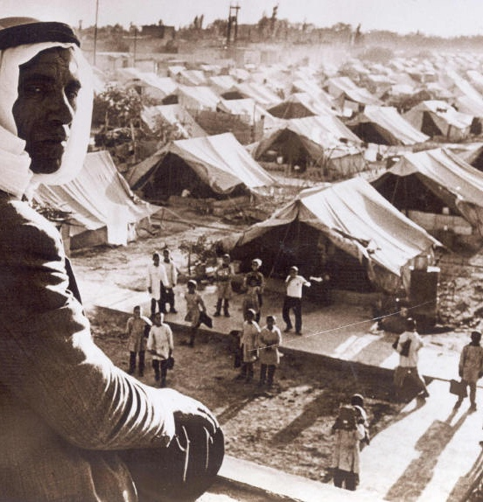
The Palestinian refugee crisis
Refugee: someone who cannot or will not return home due to well-founded fear of persecution
Right of Return: a principle in international law which guarantees everyone’s right to return to their country
After the Nakba, 750,000 Palestinians became refugees
Many went to refugee camps in Jordan, Lebanon and Syria where 55 massive tented camps were established
In 1948, the UN adopted Resolution 194, which stated that Palestinian refugees should be able to return to their homes or be financially compensated
In December 1949, UNRWA (the United Nations Relief and Works Agency for Palestinian Refugees) was set up to help with these camps
To this day, Palestinians are still fighting for their Right of Return: they did not leave voluntarily, but because they were forced out or feared persecution (eg. massacres) - we will return to this in future lessons
Today, there are an estimated 7 million Palestinian refugees
With a partner: put yourselves in the shoes of a Palestinian in 1948. Do you have a right to return to Palestine? Use UN Resolution 194 and the Right of Return to support your argument
Palestinian man at a refugee camp in Syria

Slide 25
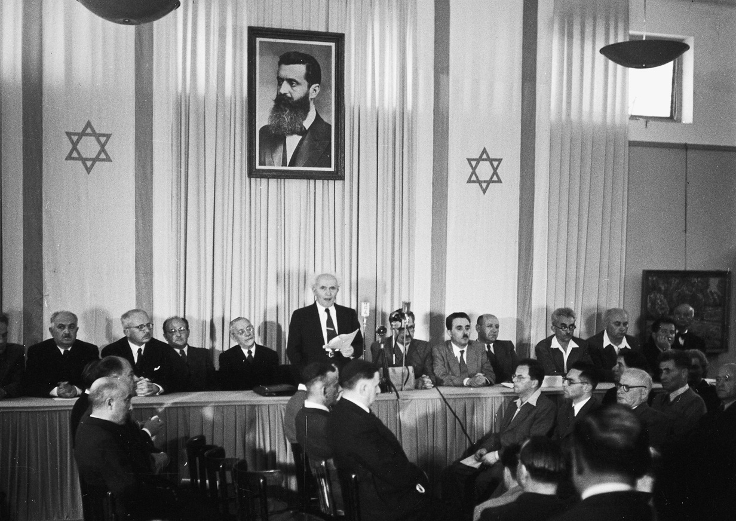
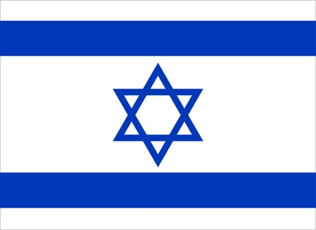
The creation of the state of Israel
At 4pm on 14th May 1948, David Ben-Gurion announced the establishment of the state of Israel. For many Jews, this was the “Year of Liberation”. Jews had suffered persecution for centuries, as we have seen in previous lessons
The USA and the USSR (Russia) immediately recognised the new state of Israel, but many of the surrounding Arab states denounced it, as they sympathised with the situation of the Palestinians
On 15th May 1948, the Arab-Israeli war began. This involved much fighting for territory between the new state of Israel and the Arab countries of Egypt, Jordan, Syria, Iraq and Lebanon
Over 6000 Jews were killed and many more Arabs (including Palestinians)
By the end of the fighting, Israel had 78% of the land of Mandate Palestine
In 1950 Israel established the ‘Law of Return’: this stated that any Jew in the world had the right to travel to Israel and become an Israeli citizen

Slide 26
1948: catastrophe or liberation?
Extension question: what is the difference between the ‘Right of Return’ and the ‘Law of Return’?
In small groups, reflect on these questions:
Was 1948 a year of catastrophe or liberation?
Why?

Slide 27
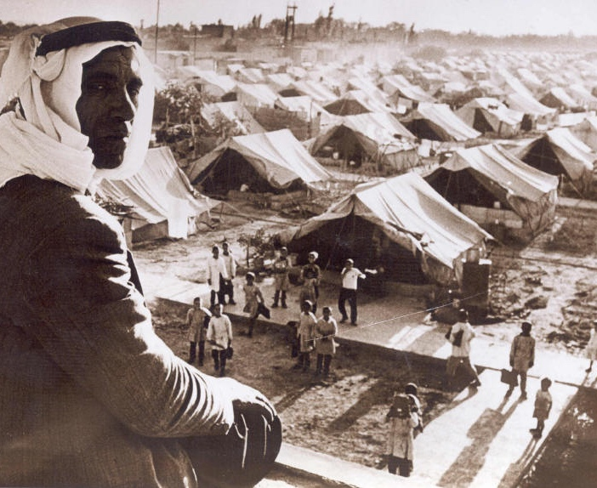
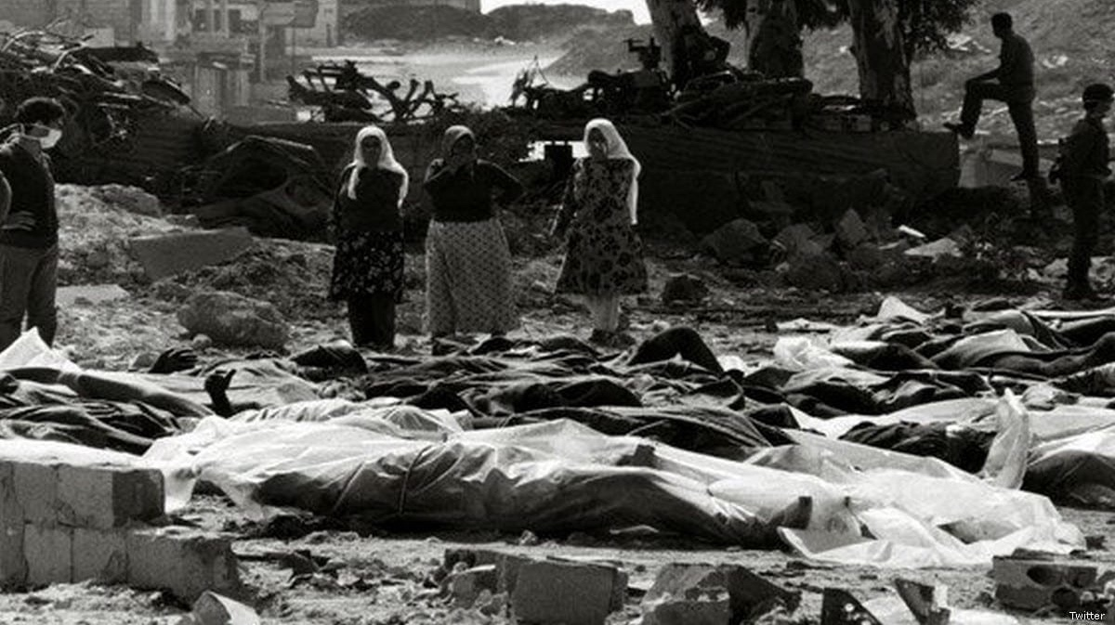
Plenary
What was the Nakba? What happened?
What were the consequence of the Nakba for the Palestinians?

Slide 28
Chapter One Recap

Slide 29
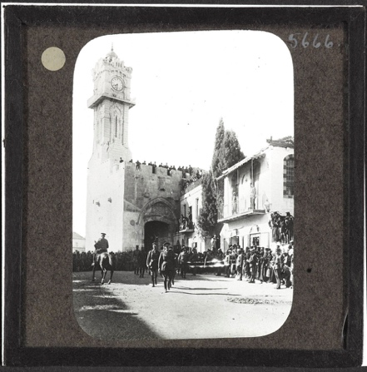
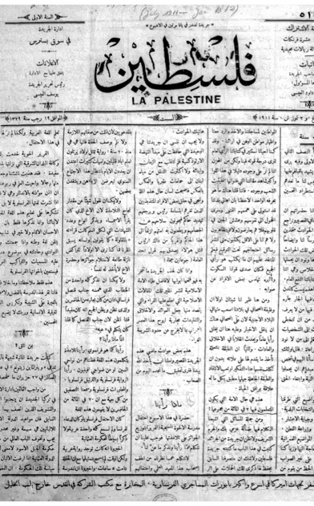
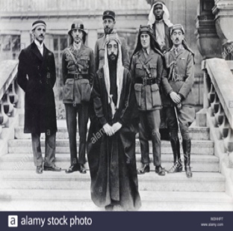
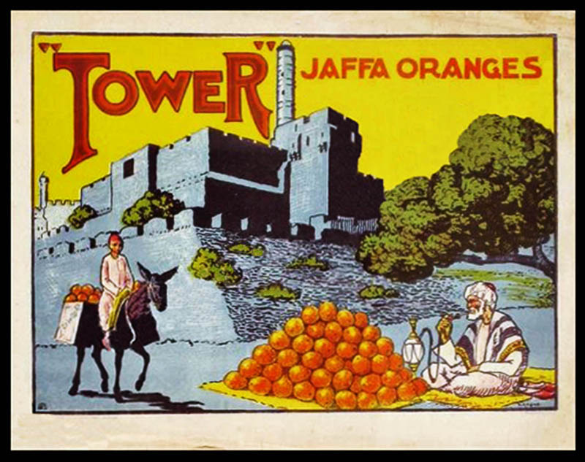
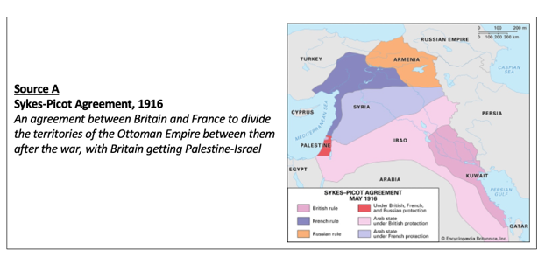
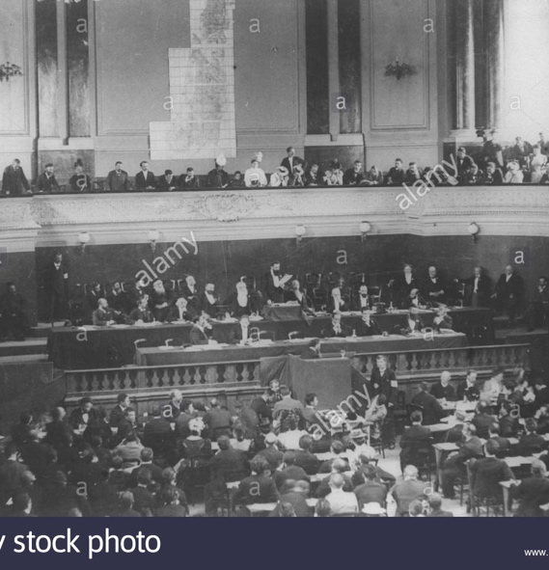
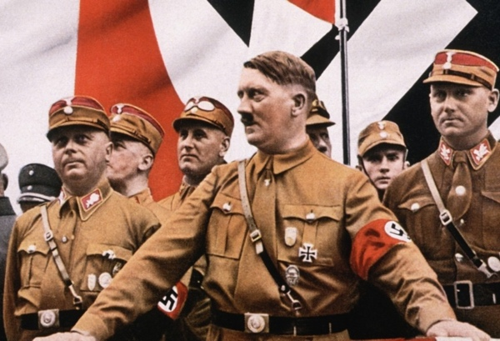
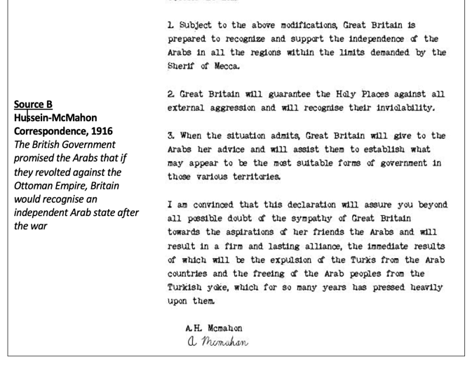
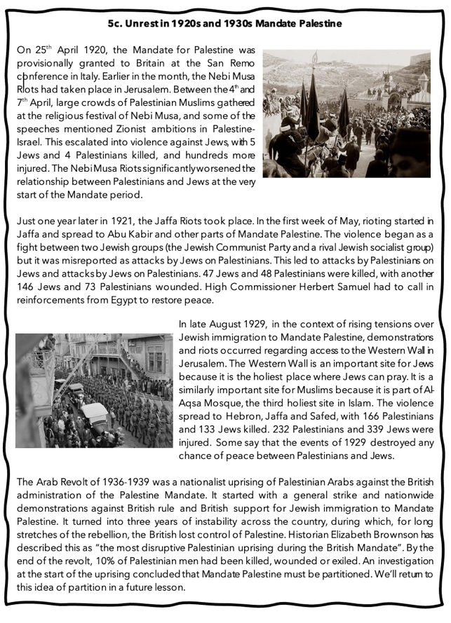
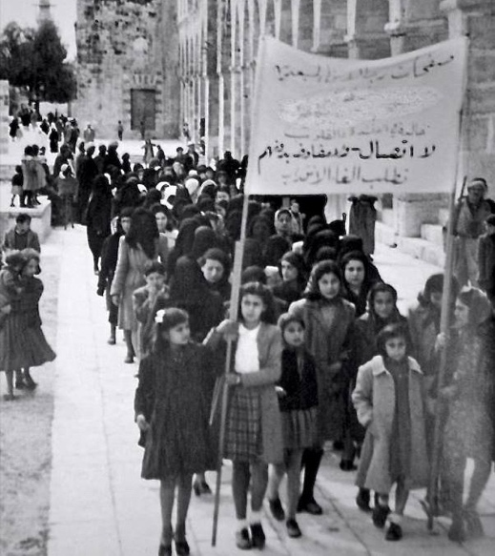
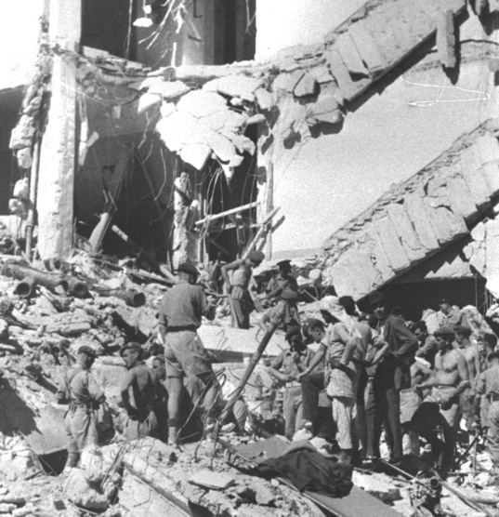
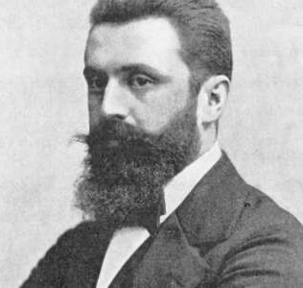
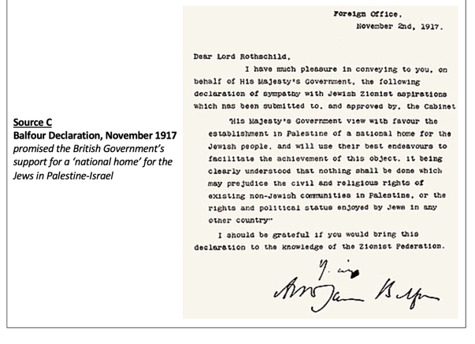
What have we covered so far? Use these images to help you

Slide 30
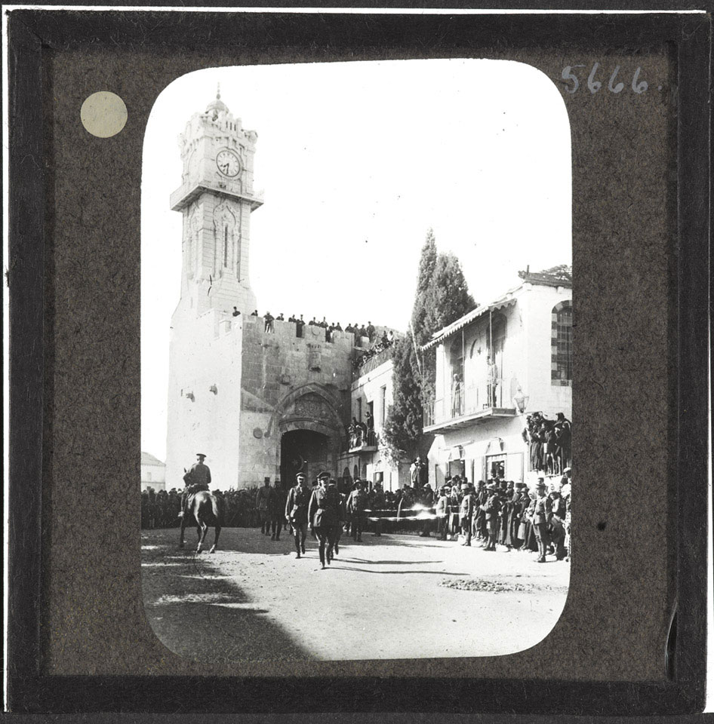
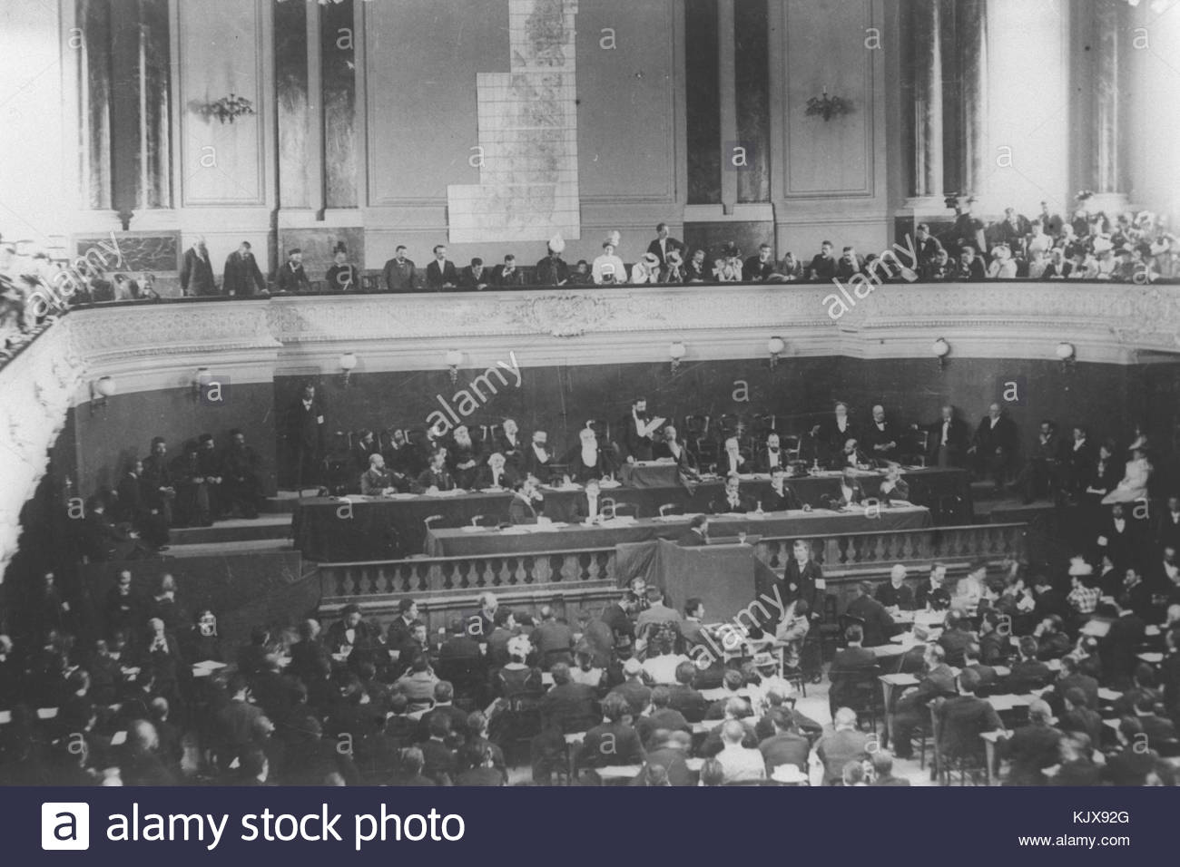
What have we covered so far? Use these images to help you
L1: Was Palestine an ‘empty land’ in the nineteenth century?
L2: Why was Zionism established in the nineteenth century?
L3: What are the origins of the Palestinian national movement?
L4: Why did Britain govern Palestine-Israel between 1920 and 1948?
L5: What happened in 1920s and 1930s Mandate Palestine?
L6: What were the consequences of WW2 for Mandate Palestine?
L7: What were the consequences of the Nakba for the Palestinians?

Slide 31
7e. Checking our misconceptions Write ‘true’ or ‘false’ under each statement
“The Palestine-Israel issue has been raging for centuries!”
“Palestine was an ‘empty land’ in the nineteenth century!”
“Zionism is just another word for Judaism!”
“The Palestine-Israel issue is all about religion!”
“The Palestine-Israel issue is unique… you can’t compare it with anything else!”
Once you have done this, compare your answers to Activity 1a from Lesson 1. In small groups, discuss why your answers are different now. What have you learnt that has changed your mind?

Slide 32
7f. Homework: Exam-style questions on Chapter One
Explain two consequences of the First World War for Palestine-Israel (8 marks)
Write a narrative account analysing the key events of the 1930s and 1940s that led to the British withdrawal from Mandate Palestine (8 marks)
Explain two of the following:
The importance of Zionism for the creation of Israel in 1948
The importance of the Nakba for the Palestinians (16 marks)

